Slide 1
Analysis of dataset- Top Spotify Songs of 2023
Course: AAI 695-A
Team- 24

Slide 2
Introduction
Dataset
This dataset contains a comprehensive list of the most famous songs of 2023 as listed on Spotify. The dataset offers a wealth of features beyond what is typically available in similar datasets. It provides insights into each song's attributes, popularity, and presence on various music platforms. The dataset includes information such as track name, artist(s) name, release date, Spotify playlists and charts, streaming statistics, Apple Music presence, Deezer presence, Shazam charts, and various audio features.
Link: https://www.kaggle.com/datasets/nelgiriyewithana/top-spotify-songs-2023/data
Author: Nidula Elgiriyewithana

Slide 3
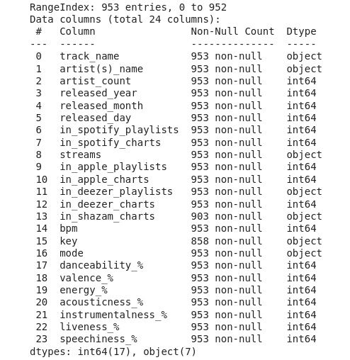
Dataset
Columns

Slide 4
Dataset
Data engineered columns
Added additional categorical columns by converting the percentage columns to categorical values in steps of 25%.
Added a Maximum percentage column which showed attribute a song had a maximum of.
Added numeric mappings for the key and mode columns.
For the ‘streams’ and ‘in_spotify_playlists’ columns we added additional categorical columns which assign categories based on percentile within the dataset.
In total we added 12 new columns by data engineering.

Slide 5
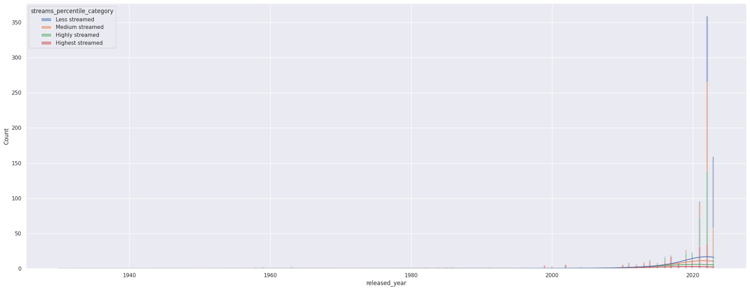
Dataset EDA
Counts of songs by year with the amount streamed as hue
Added additional categorical columns by converting the percentage columns to categorical values in steps of 25%.
Added a Maximum percentage column which showed attribute a song had a maximum of.
Added numeric mappings for the key and mode columns.
For the ‘streams’ and ‘in_spotify_playlists’ columns we added additional categorical columns which assign categories based on percentile within the dataset.
In total we added 12 new columns by data engineering.

Slide 6
Dataset EDA
Counts of songs by year with the amount streamed as hue
Majority of the songs in the 2023 top streamed list were from year 2022 followed by 2023 and 2021.
The songs from 2023 are relatively less streamed as they haven’t had as much time to accumulate stream count.

Slide 7
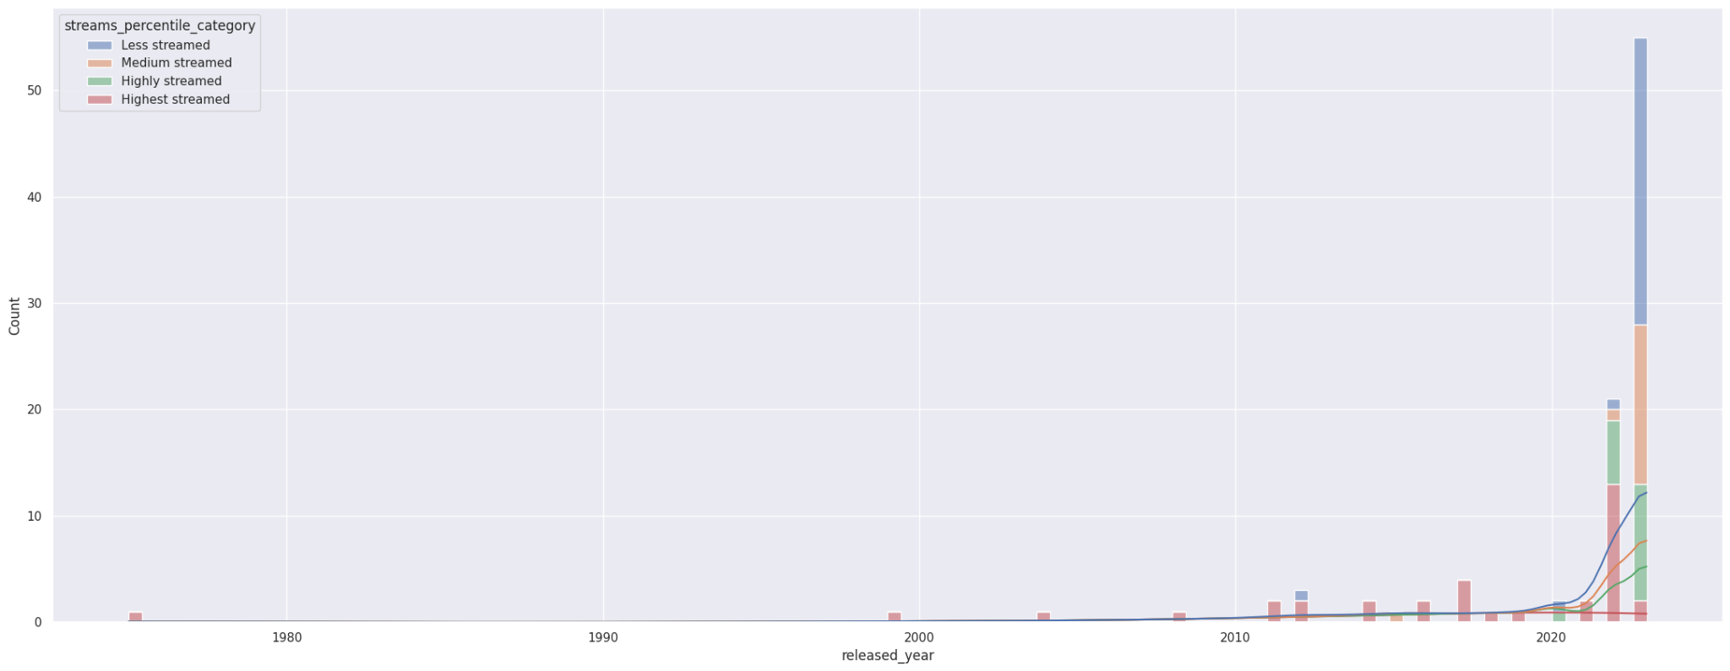
Dataset EDA
Counts of songs by year with the amount streamed as hue- Top 200

Slide 8
Dataset EDA
Counts of songs by year with the amount streamed as hue - Top 200
Majority of the songs in the top 200 2023 top streamed list are from year 2023 followed by 2022.
The songs from 2023 are relatively less streamed as they haven’t had as much time to accumulate stream count.

Slide 9
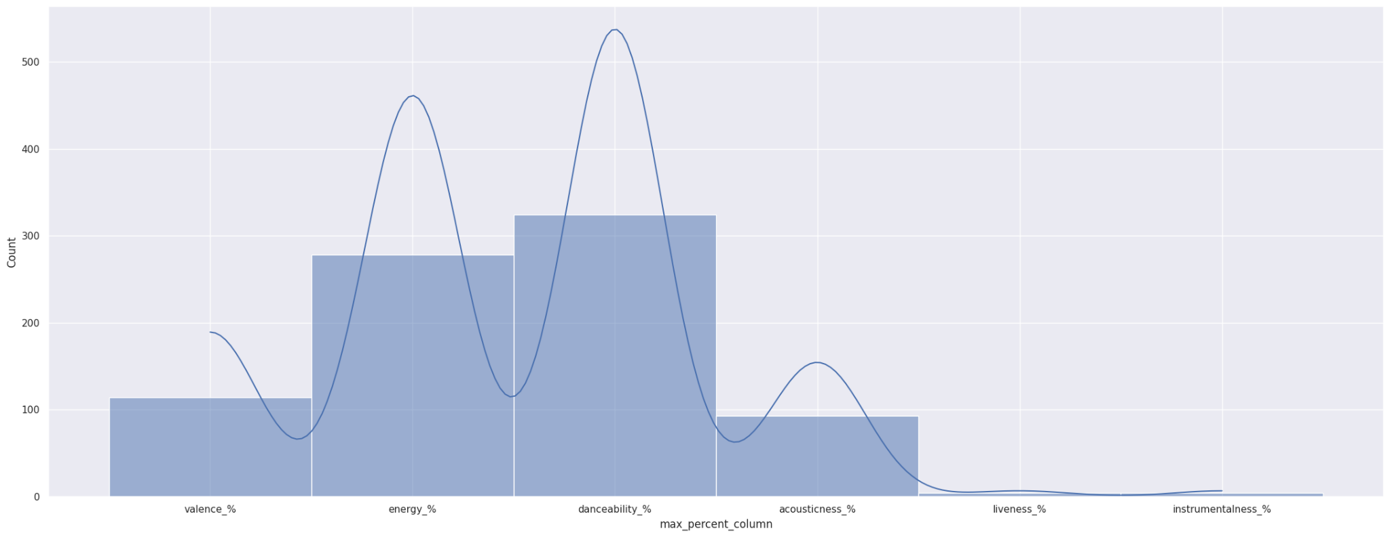
Dataset EDA
Plot of the highest valued attributes vs Count

Slide 10
Dataset EDA
Plot of the highest valued attributes vs Count
Songs with high danceability have featured the most in the top streamed list followed by energy.
Liveness and Instrumentalness seem to matter least for a song to be popular.

Slide 11
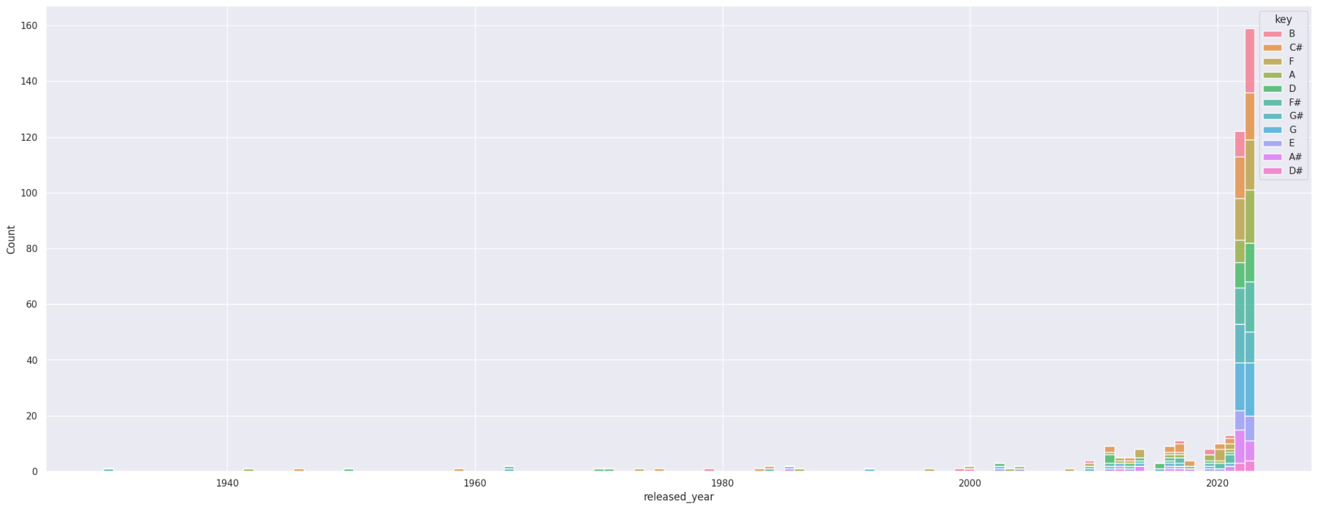
Dataset EDA
Plot of a release year vs count with key as the hue for top 400 songs

Slide 12
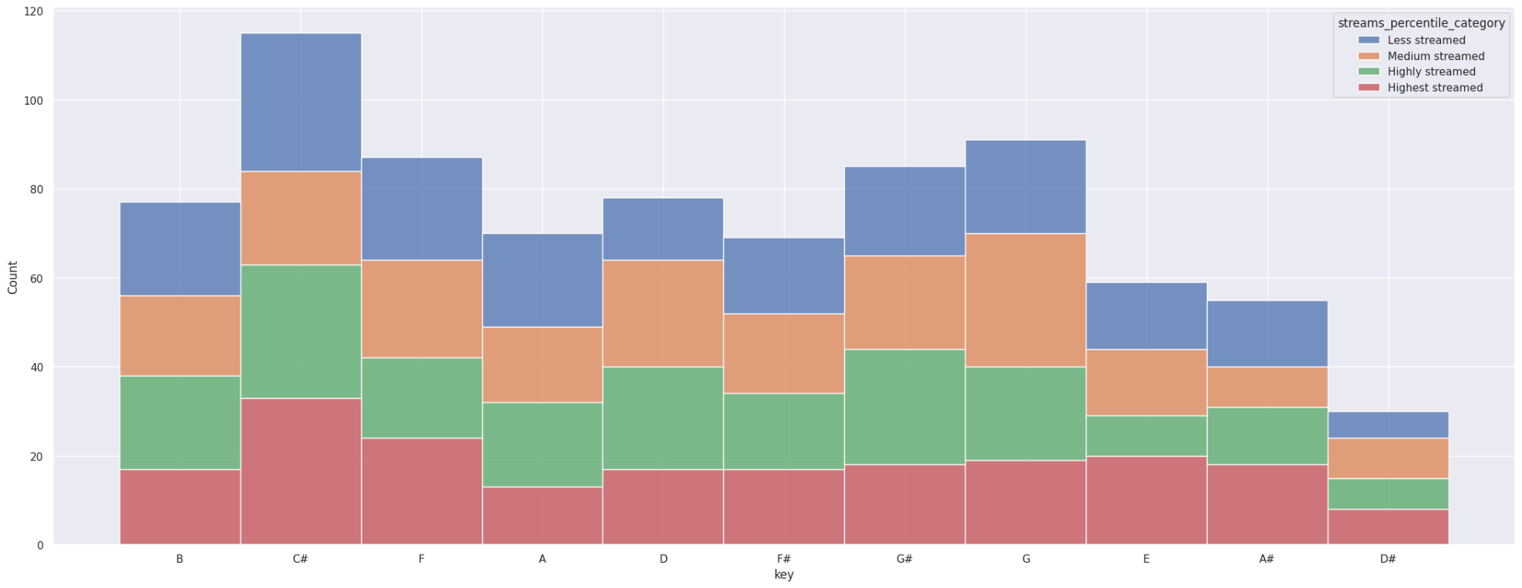
Dataset EDA
Plot of Key vs count with popularity as hue for all songs

Slide 13
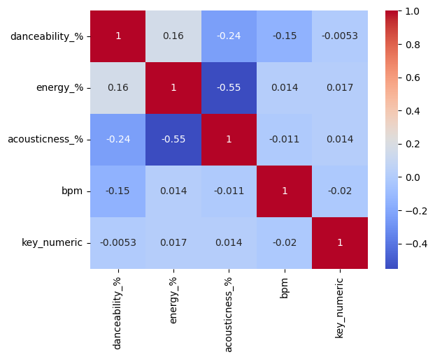
Dataset EDA
Correlation Analysis

Slide 14
Dataset EDA
Correlation Analysis
Acousticness has a negative correlation with Energy and Danceability.
Energy and Danceability have a positive correlation.

Slide 15
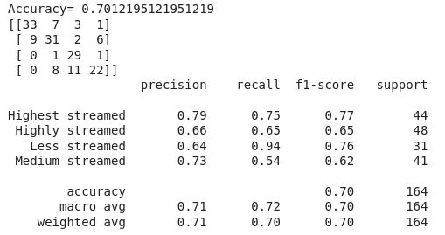
Models
Random forest to predict the popularity/ amount streamed
Features: ['bpm','danceability_%', 'valence_%', 'energy_%', 'acousticness_%','instrumentalness_%', 'liveness_%', 'speechiness_%', 'key_numeric','mode','in_spotify_playlists', 'in_spotify_charts','in_apple_playlists', 'in_apple_charts', 'in_deezer_playlists','in_deezer_charts', 'in_shazam_charts']
Target: streams_percentile_category

Slide 16
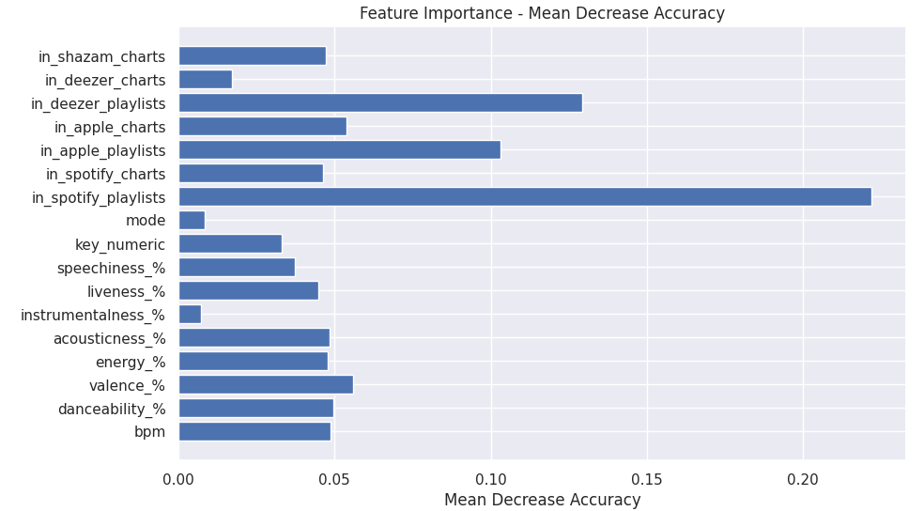
Models
Random forest to predict the popularity/ amount streamed- Feature importance

Slide 17
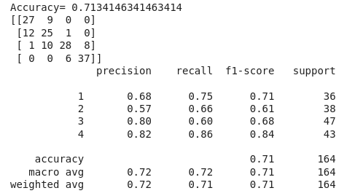
Models
Random forest for classifying number of Spotify playlists a song will be in.
features=['streams','bpm','danceability_%', 'valence_%', 'energy_%', 'acousticness_%','instrumentalness_%', 'liveness_%', 'speechiness_%', 'key_numeric','mode', 'in_spotify_charts','in_apple_playlists', 'in_apple_charts', 'in_deezer_playlists','in_deezer_charts', 'in_shazam_charts']
Target: percentile category for the number of Spotify playlists a song will appear in

Slide 18
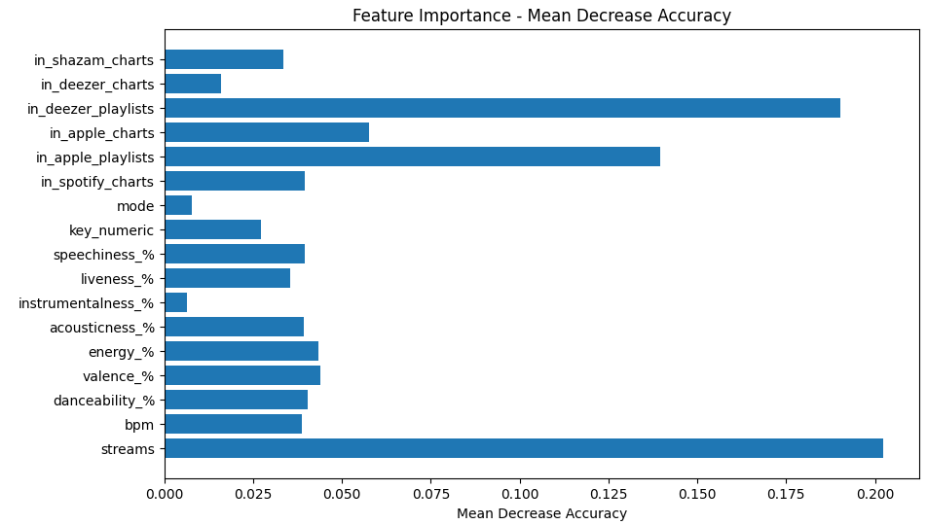
Models
Random forest for classifying number of Spotify playlists a song will be in.

Slide 19
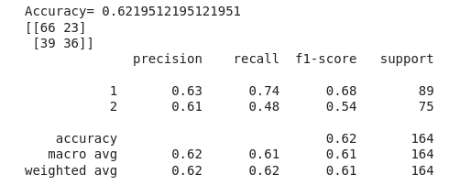
Models
Random forest to predict mode of a song
features=['danceability_%', 'valence_%', 'energy_%', 'acousticness_%','instrumentalness_%', 'liveness_%', 'speechiness_%', 'key_numeric']
Target: Mode of a song

Slide 20
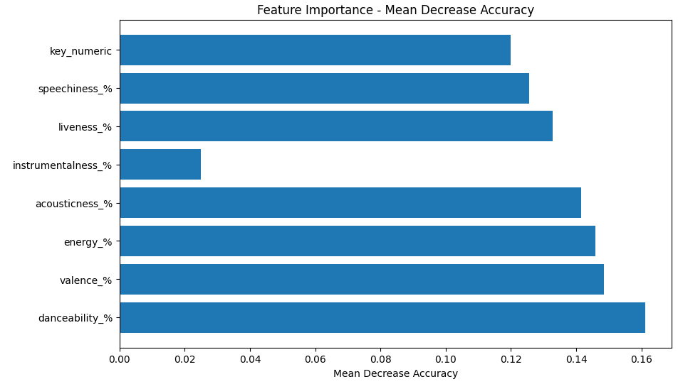
Models
Random forest to predict mode of a song

Slide 21

Models
K Means to predict mode of a song
features=['danceability_%', 'valence_%', 'energy_%', 'acousticness_%','instrumentalness_%', 'liveness_%', 'speechiness_%', 'key_numeric']
Target: Mode of a song

Slide 22
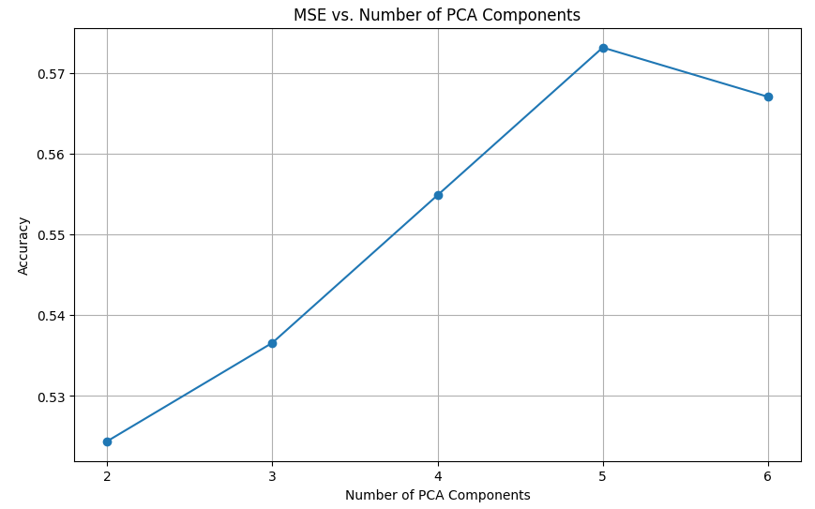
Models
Logistic regression to predict mode of a song
features=['danceability_%', 'valence_%', 'energy_%', 'acousticness_%','instrumentalness_%', 'liveness_%', 'speechiness_%', 'key_numeric']
Target: Mode of a song
5 PCA components work best.

Slide 23
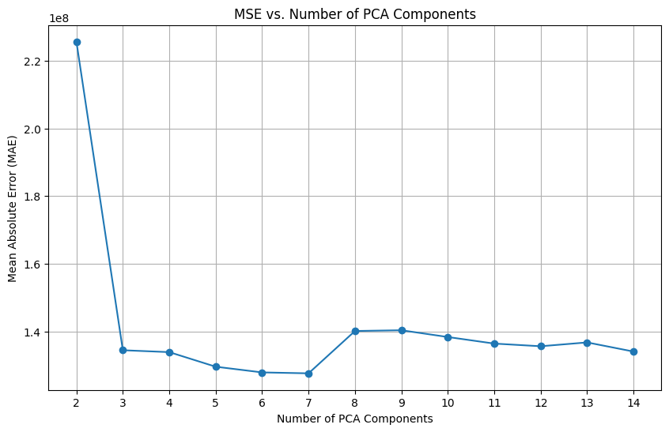
Models
Lasso regression to predict number of streams with PCA
features= All columns except ‘streams’.
Target: streams
3 PCA components are ideal.
The MAE is high but minimum value for streams is 2762 and maximum is 3562543890.

Slide 24
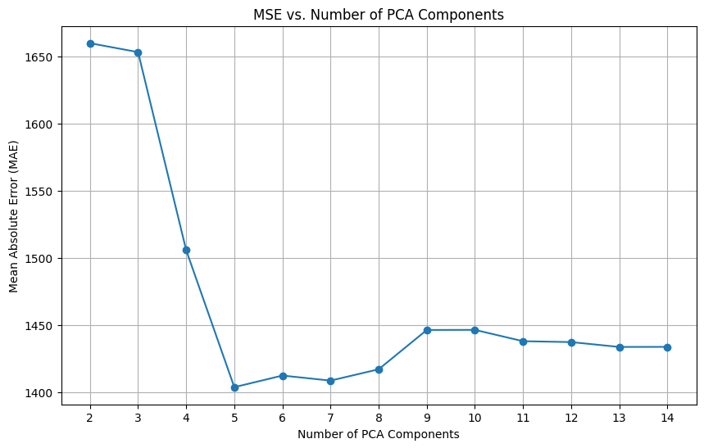
Models
Lasso regression to predict number of spotify playlists the song will be in
features= All columns except ‘streams’.
Target: in_spotify_playlists
3 PCA components are ideal.
The MAE is good as minimum value for in_spotify_playlists is 31 and maximum is 52898.

Slide 25
Conclusion
In conclusion, the predictive modeling for music streaming services, as exemplified by platforms like Spotify, has made significant strides. The use of various machine learning techniques has enabled a better understanding of user preferences and streaming patterns. However, there remains a substantial scope for improvement and innovation. Future research directions, including the integration of advanced machine learning models, additional data sources, and real-time analytics, promise to further enhance the accuracy and personalization of these predictions. By continuing to evolve these algorithms, streaming services can offer more tailored experiences to users, benefiting both the platforms and the music industry at large. As technology and data availability continue to expand, so too will the opportunities for deeper insights and more sophisticated predictive capabilities in the dynamic and ever-evolving domain of music streaming.

Slide 26
Link to Zoom recording
link: https://stevens.zoom.us/rec/share/vyuervA9CmEP9mS1OaIOIijxYdtH4lcybumFuZMk7v29hQD0VnPw6hv9O0TDUry7.cG3qUO3MreXIXySN?startTime=1702692731000

